Slide 1
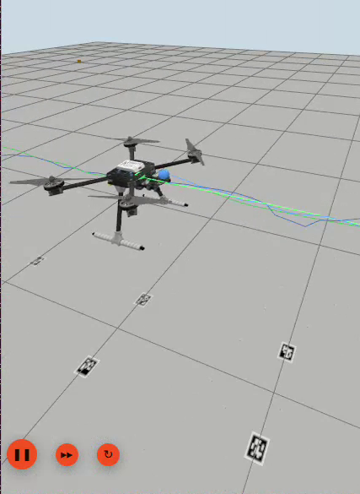
TRANSFINITTE 26’ · IMU SENSOR FUSION
IMU Based Position Sensing For Drones and Robots (PS 4)
40 hours of IMU and UWB sensor fusion
Team MAJoRS
Aditya Ganta · Joshua John · Saiprakash · Michelle · Rahul
Github Repo link
Notes:
Open with the question, not the answer. We had forty hours and one problem: a phone grade IMU loses its position in seconds, so how far can a cheap correction sensor pull it back? The picture on the right is our end result, a PX4 drone in Gazebo with two paths drawn on the floor, the true one and our filter's estimate. The rest of the deck is the order in which we earned that picture.

Slide 2





OVERVIEW
H3
H10
H24
H30
H40
What we set out to build
Filters
The question
KF, EKF and ESKF, built and compared
Can a noisy phone IMU plus a sparse position fix track a moving drone, and can we prove it against ground truth?
Accelerometer drift
How fast a bare IMU loses its position
Noise model
Measured on real hardware, not assumed
Simulation
A drone in Gazebo with a noisy IMU and UWB
Ground truth vs estimate
Same path, two lines, one error number
Notes:
This is the deliverable in one slide: five pieces, each backed by something in the repo. Filters (KF, EKF, ESKF), accelerometer drift analysis, a noise model from real hardware, a simulation with noisy IMU and UWB, and a ground truth versus estimate comparison. Adjust the wording here to match the official problem statement.

Slide 3
OVERVIEW
H3
H10
H24
H30
H40
Our setup at a glance
Phone IMU
395 Hz
1 hour static
recording
Allan noise
model
Synthetic IMU
generator
Real phone
Gazebo drone
PX4 x500
Phone noise IMU
+ 8 UWB anchors
15 state
ESKF
Estimate vs
ground truth
Simulation
Phone IMU
+ back camera
AprilTag track
on the floor
ESKF with
camera fixes
Path vs
tag positions
Real motion
The noise model from lane one is what makes the simulated IMU behave like our phone.
Notes:
Three lanes, read left to right. Lane one is the real phone: we record it for an hour, measure its noise, and turn that into a generator. Lane two is simulation: a Gazebo drone whose IMU carries exactly that noise, plus eight UWB anchors, feeding our ESKF, compared against ground truth. Lane three is the real world proof of concept: we had no UWB hardware, so a phone camera reading AprilTags stands in as the position sensor. Same filter family, three levels of realism.

Slide 4






THE 40 HOUR STORY
H3
H10
H24
H30
H40
Forty hours, Six chapters – Our Timeline
Width of each bar is hours spent. Orange chapters are where most of the work landed.
H3 to 4
H5 to 8
H8 to 9
H10 to 24
H24 to 30
H30 to 40
Ideate
Learn every filter
Split the work
Phone IMU, drift, noise
ESKF with UWB
Simulate and prove
What to build and measure
Complementary up to ESKF
Five lanes, one repo
ADB stream, Allan, bias
Code, i-ASL, synthetic noise
Gazebo and a real walk
Notes:
This is the spine of the talk. Six chapters over forty hours. The two orange ones are where the real engineering happened: hours ten to twenty four, where we turned a phone into a measurement instrument, and hours thirty to forty, where we proved the filter in simulation and on a real walk.

Slide 5
HOURS 3 TO 9 IDEATE, LEARN, SPLIT
H3
H10
H24
H30
H40
Hours 3 to 9: Brainstorm
H3 to 4
H5 to 8
H8 to 9
Ideation and discussion
Everyone learns every filter
Split the work and ideate again
What to build, what to measure, what to simulate
Nobody specialised until everyone could read the maths
Five lanes, one shared repo
Steps we took
ESKF
EKF
Kalman filter
Mahony and Madgwick
Complementary
Notes:
Hours three and four were pure argument: phone or hardware, what is the correction sensor, what do we simulate. Hours five to eight, all five of us learned the same ladder of filters, from a complementary filter up through Mahony and Madgwick, the Kalman filter, EKF and finally the error state filter. At hour eight we split the work and ideated again, now with a shared vocabulary.

Slide 6
HOURS 8 TO 9 SPLITTING THE WORK
H3
H10
H24
H30
H40
Five people, five lanes
AG
Aditya Ganta
JJ
Joshua John
SP
Saiprakash
IMU calibration and bias estimation
Phone IMU over ADB and SensorServer. Gazebo drone with UWB
Orientation GUI, six channel static signals, noise and drift
R
Rahul
M
Michelle
Kalman filters, synthetic signals, ESKF vs ground truth in simulation
Allan based noise model, i-ASL dataset, UWB positioning
Notes:
Aditya took IMU calibration and bias estimation. Joshua found the trick that made the whole project possible, pulling the phone's raw IMU through developer options, ADB and the SensorServer app, and later started the Gazebo drone. Saiprakash took the stream from there: orientation estimation in a GUI, six channel static recordings, noise model and drift analysis. Rahul built the Kalman filters and the synthetic signals, then the ground truth versus estimate in simulation. Michelle replaced the Gaussian assumption with the real Allan deviation noise and found the i-ASL dataset. Michelle and Rahul together did indoor positioning with UWB as the correction sensor.

Slide 7
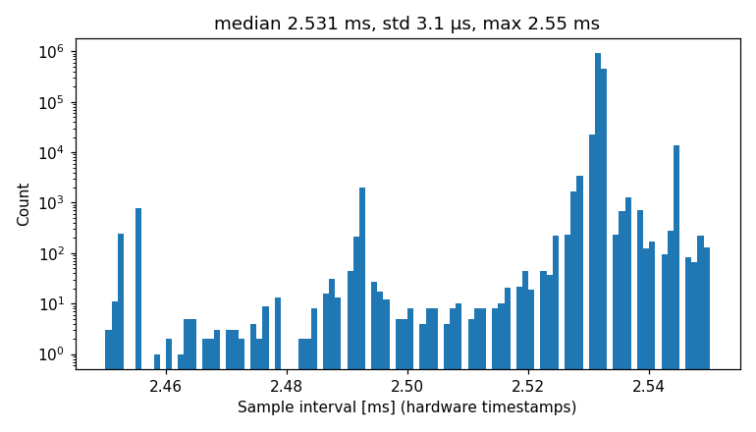
HOURS 10 TO 24 PHONE IMU, DRIFT AND NOISE
H3
H10
H24
H30
H40
The phone becomes our IMU
Phone
SensorServer app
USB cable
adb forward :8080
WebSocket
every event
Python logger
hardware timestamps
imu.csv
+ raw streams
395 Hz
3 µs
the rate that held, every event kept
timing jitter, std
0 lost
Phone IMU
of 1.42 million samples in an hour
Bosch BMI26x in a CPH2661, accel + gyro, AK0991x Magnetometer
Notes:
This was the major piece of work. Joshua's idea: skip extra hardware and use the phone's own IMU. Developer options plus ADB give us a USB tunnel, adb forward on port 8080, to the SensorServer app, which exposes the sensors over a WebSocket. Our first design polled the latest value and dropped about half the samples. The fix was to keep every event with its hardware timestamp, never the laptop arrival time. That gives about 395 Hz with three microseconds of jitter and zero lost samples across a one hour recording, 1.42 million samples. Android's power management is the enemy of a long recording, so the test console checks over adb that the phone is charging, set to stay awake and has the app in the foreground before it lets a run start. The histogram is the time between samples: every interval falls between 2.45 and 2.55 milliseconds.

Slide 8
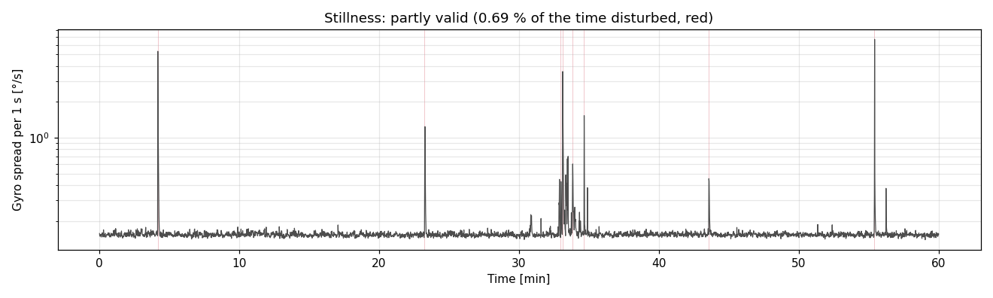
HOURS 10 TO 24 PHONE IMU, DRIFT AND NOISE
H3
H10
H24
H30
H40
Static Sampling for Noise Evaluation
0.69 %
19 min
33 to 36 °C
of the hour disturbed
clean stretch used for the noise model
battery temperature over the run
Notes:
Gyro spread per second across the hour with the phone flat on a table. The spikes are us bumping the table or the cable, flagged automatically in red and excluded. The analysis uses only the longest undisturbed stretch, about nineteen minutes, for the noise model, and 45 undisturbed one minute segments for the drift statistics. Being honest about disturbed data is what makes the numbers on the next slides trustworthy.

Slide 9
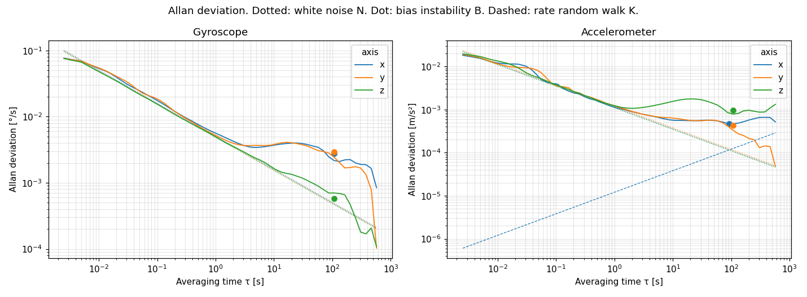
HOURS 10 TO 24 PHONE IMU, DRIFT AND NOISE
H3
H10
H24
H30
H40
Allan Deviation and Variance
15 °/h
5 m°/s/√Hz
114 µg/√Hz
gyro bias instability
gyro white noise
accelerometer noise
Notes:
Allan deviation is how you read an IMU's noise: the falling slope is white noise, the flat bottom is bias instability, the rising tail is random walk. One hour of data gave us per axis numbers: gyro bias instability around fifteen degrees per hour on x and y and three on z, gyro white noise about five millidegrees per second per root hertz, accelerometer noise about 114 micro g per root hertz. This curve is the fingerprint we later copy into the simulator.

Slide 10
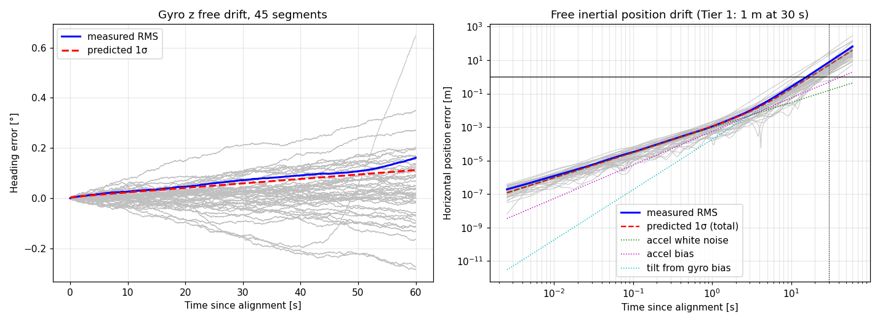
HOURS 10 TO 24 PHONE IMU, DRIFT AND NOISE
H3
H10
H24
H30
H40
Drift Prediction and Analysis
7.5 m
0.072°
4.98 m
75 km
position drift at 30 s
heading drift at 30 s
of it from gyro bias tilt
after 19 min unaided
Notes:
Left plot: heading error of 45 one minute segments, measured RMS in blue, our noise model's prediction in red. Right plot: free inertial position error on a log scale. After thirty seconds on a table the phone believes it moved 7.5 metres, our model predicted 5, and almost all of it comes from the gyro bias tilting gravity into the horizontal axes. That is why we estimate and subtract gyro bias, about 0.20, minus 0.35 and 0.09 degrees per second on x, y and z. Integrate for nineteen minutes and the error is 75 kilometres. No aiding means no navigation.

Slide 11

HOURS 24 TO 30 ESKF WITH UWB
H3
H10
H24
H30
H40
ESKF: the IMU predicts, sensors correct
Predict
15 state error filter
Correct
IMU integrated at 100 to 395 Hz
8 UWB ranges
dp position
dv velocity
Gravity direction, adaptive
position, velocity, attitude, accel and gyro bias
dθ attitude
Magnetometer heading
db_{a} accel bias
Zero velocity at rest
db_{g} gyro bias
Camera tag fixes
Notes:
Hours twenty four to thirty: from theory to code. The ESKF keeps a small error state, fifteen numbers, and the IMU does the heavy lifting between corrections. Corrections are whatever the scenario offers: eight UWB ranges in simulation and on the i-ASL dataset, a gravity direction update that fades out during manoeuvres, a magnetometer for heading, zero velocity updates when still, and camera tag fixes in the real walk.

Slide 12
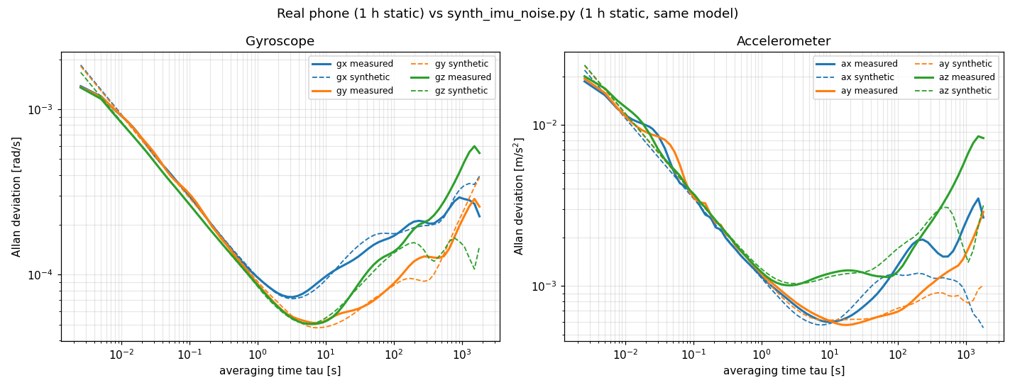
HOURS 24 TO 30 ESKF WITH UWB
H3
H10
H24
H30
H40
Noise Modelling for simulating synthetic signals
Solid: real phone, 1 hour. Dashed: our generator, same model, 1 hour.
white noise · bias instability · rate random walk · turn on bias · quantisation
Notes:
Rahul's first synthetic signals used plain Gaussian noise. Michelle replaced that with the model measured from the Allan plots. The proof is this chart: the dashed synthetic curves lie on top of the real phone's curves from milliseconds to thousands of seconds. Five terms: white noise, Gauss Markov bias instability, bias random walk, a constant turn on bias, and rounding to the sensor's LSB. The generator is a single small file, synth_imu_noise.py, so anyone can reuse it.

Slide 13
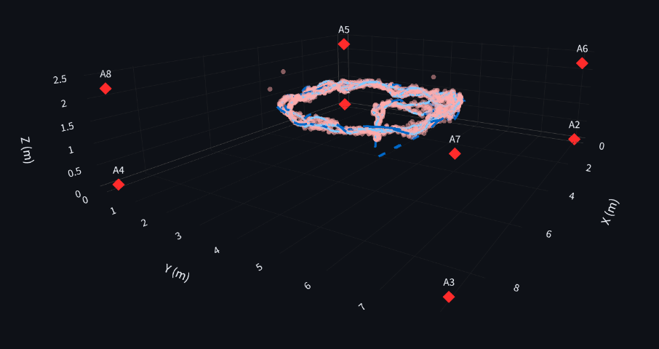
HOURS 24 TO 30 ESKF WITH UWB
H3
H10
H24
H30
H40
UWB Sensor Fusion using i-ASL Dataset
Integrated UWB to correct the Drift
i-ASL Dataset contains UWB sensor values coupled with IMU data and their corresponding True Position for comparison
Model Validation
We used this dataset to validate out modelled ESKF estimator and succeeded
Accurate Position Estimation
UWBs improve the accuracy of position estimation over the accelerometer data
Notes:
Michelle found the i-ASL UWB plus IMU dataset, a public benchmark with mocap ground truth. Our first result was a humbling 6.6 metre error. Three bugs, in order of size: the ground truth lives in the Qualisys frame, a pure translation of about 4.5 metres, worth about 6.3 metres of apparent error. Second, our anchor table did not match the yaml file, which mirrored the geometry and cost another two metres of real filter error. Third, the mocap clock is out by up to a second, and the IMU CSV had whole second timestamps, which we fixed by reading true stamps from the rosbags. After the fixes the ESKF sits at 0.14 to 0.21 metres across the three scenarios. This is the slide to show that we debug against data, not feelings.

Slide 14
HOURS 30 TO 40 SIMULATE AND PROVE
H3
H10
H24
H30
H40
Why our ESKF lost to the EKF, and the fix
Cause
No gravity measurement, so roll and pitch drifted with gyro bias
Fix
Adaptive gravity update that fades out during manoeuvres
Price
Fixed gravity noise doubled position error in a 3.5 m/s² loop, 0.05 to 0.10 m. Adaptive: 0.051 m
Notes:
Fine tuning, hours thirty to forty. Our attitude ESKF was far worse than the plain EKF, with yaw errors of thirteen degrees over thirty seconds. The cause was simple once we looked: the ESKF had no accelerometer gravity measurement, so roll and pitch were never corrected and drifted with gyro bias, which then corrupted the magnetometer heading too. We added a gravity update whose noise inflates when the vehicle accelerates, so it fades out during manoeuvres. Errors dropped to 0.47, 0.34 and 1.27 degrees, within a tenth of a degree of the EKF. A naive fixed noise version doubled position error in an aggressive loop, which is why the adaptive version matters. These numbers are from our synthetic benchmark; real i-ASL position error was unchanged at 0.14 to 0.20 metres.

Slide 15
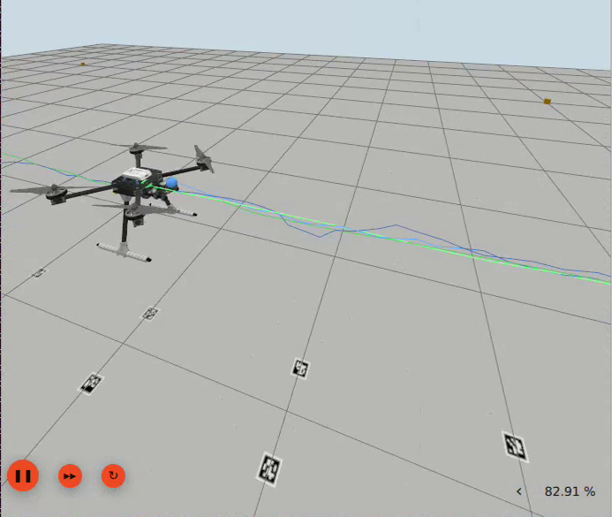
HOURS 30 TO 40 SIMULATE AND PROVE
H3
H10
H24
H30
H40
Environment Setup in Gazebo
PX4 x500
Phone noise IMU
5 straight passes over the track at 0.3 m/s for 50m , real motor physics
Integrated our measured noise model into simulation IMU noise
8 UWB anchors
ROS2
12 m cube and 8 UWB at corners of the cube
Intergrated ROS2 with Gazebo via ros_gz_bridge
Notes:
Joshua started the Gazebo simulation; the drone is a PX4 x500 flying five traversals along a floor of AprilTags at 0.3 metres per second. The sensors are ours: an IMU whose noise comes from our measured phone model through noise_to_gz.py, and eight UWB anchors on the corners of a 12 metre cube. PX4 flies on ground truth as external vision so the physics are real, but the ESKF never sees ground truth, it only gets the noisy IMU and the UWB ranges. Ground truth is used for evaluation only.

Slide 16
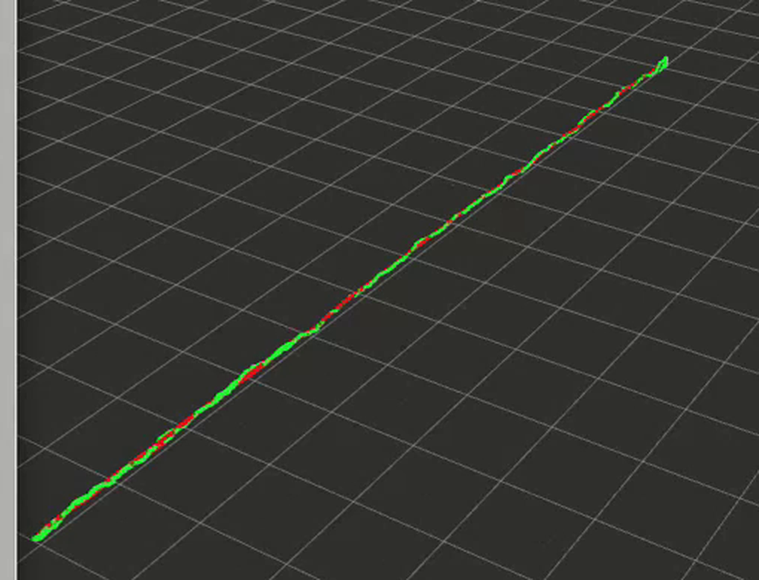
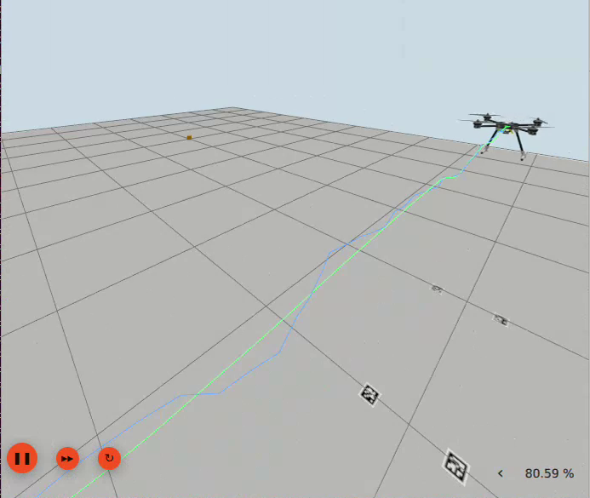
HOURS 30 TO 40 SIMULATE AND PROVE
H3
H10
H24
H30
H40
ESKF path against ground truth
RViz: green is the ESKF estimate, red is ground truth
Gazebo: both paths drawn on the floor under the drone
0.138m
live position RMSE against ground truth, 1,464 matched samples
Notes:
The money slide. Left, RViz: the green line is our ESKF estimate, the red line is the true path, and they are almost on top of each other. Middle, Gazebo with both paths drawn on the floor beneath the drone. Right, the number the live node prints to the terminal: about 0.04 metres position RMSE against ground truth, over more than fourteen hundred matched samples. The filter used only the phone noise IMU and UWB ranges.

Slide 17
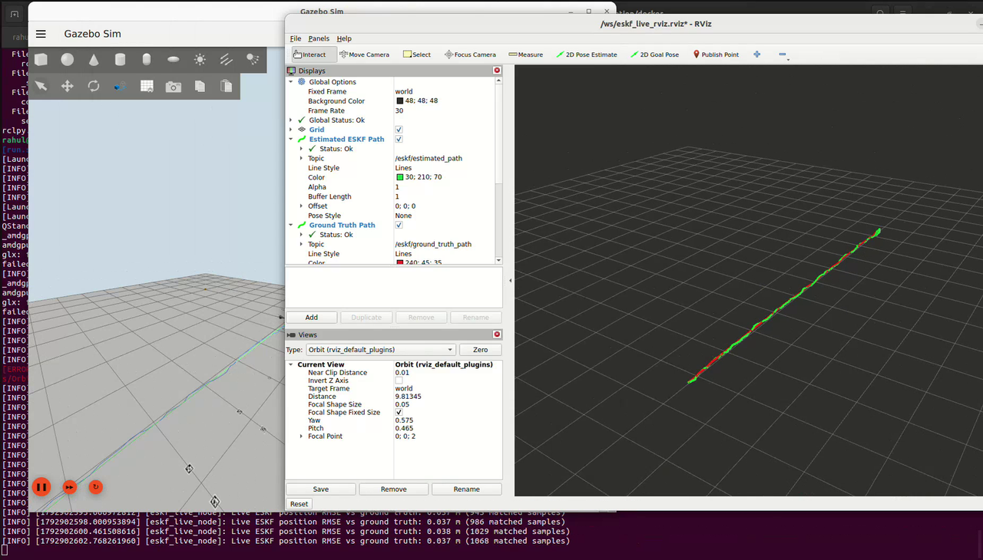
HOURS 30 TO 40 SIMULATE AND PROVE
H3
H10
H24
H30
H40
Watch the run
Notes:
Play the recording of the Gazebo run: the drone flying the track while the RViz paths grow. Terminal on the bottom prints the running RMSE.

Slide 18
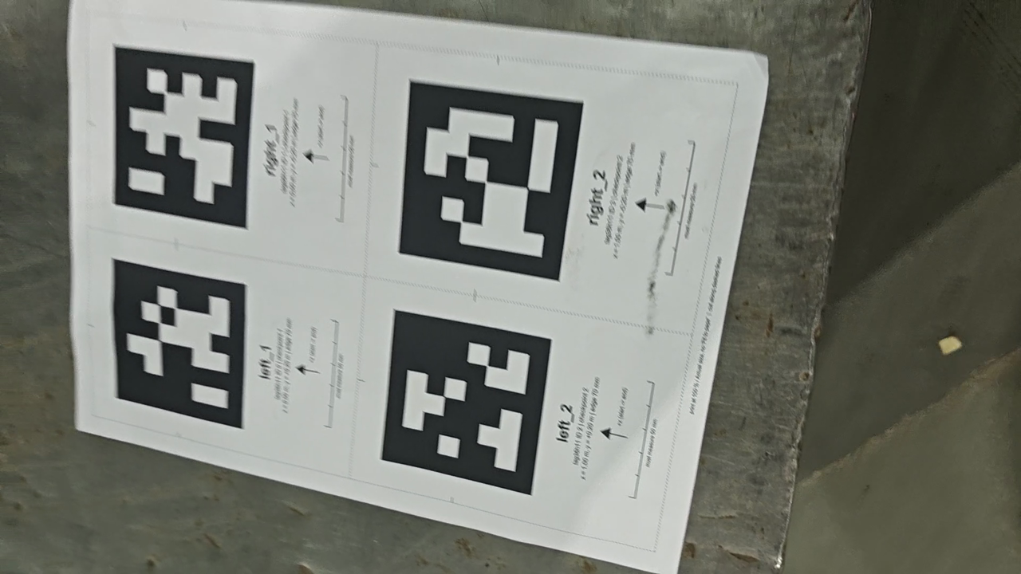
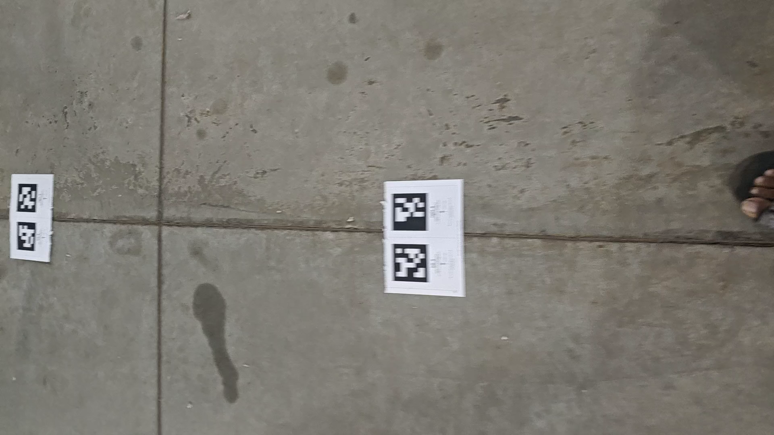
HOURS 30 TO 40 SIMULATE AND PROVE
H3
H10
H24
H30
H40
Proof of Concept – Tested ESKF estimator in hardware
AprilTag sheets, printed at size of 70x70 mm
What the phone camera sees while walking
Phone IMU at 395 Hz and the back camera at 1080p, 30 fps, recorded together. Tags give position fixes, the ESKF fills the gaps.
Notes:
We could not test on real UWB because we did not have the hardware. So for a proof of concept on real motion we used what we did have: tags printed on A4 sheets laid along the floor, and the phone's back camera as the position sensor. One command records the IMU and the video together, with a clock map to sync them, and the camera pose from each visible tag becomes a position update for the same ESKF. Honest framing: the tags are both the correction and the reference here, so this validates the IMU bridging and the fusion, not independent accuracy.

Slide 19
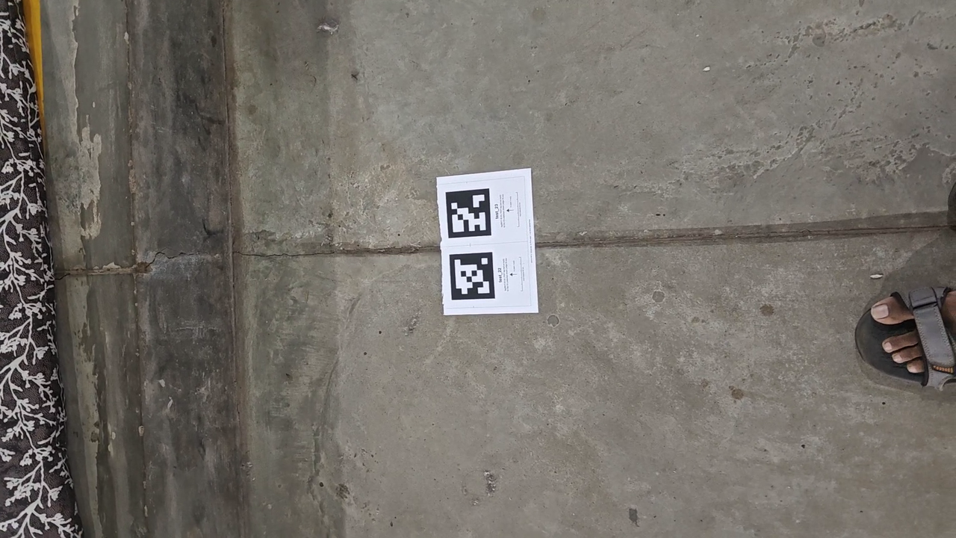
HOURS 30 TO 40 SIMULATE AND PROVE
H3
H10
H24
H30
H40
Test Run
22 April Tags
Left and right pair of April Tag at every meter
10m distance
Covering 10m distance back and forth returning to the start position
The phone's view during the walk
Notes:
The stress test. We switched the camera off for two seconds out of every four. The ESKF bridged the gaps with the IMU alone with 0.52 metres RMSE, worst case 2.2 metres. Compare with the IMU on its own, which leaves the track after 2.9 seconds. This is the whole case for sensor fusion on one slide.

Slide 20
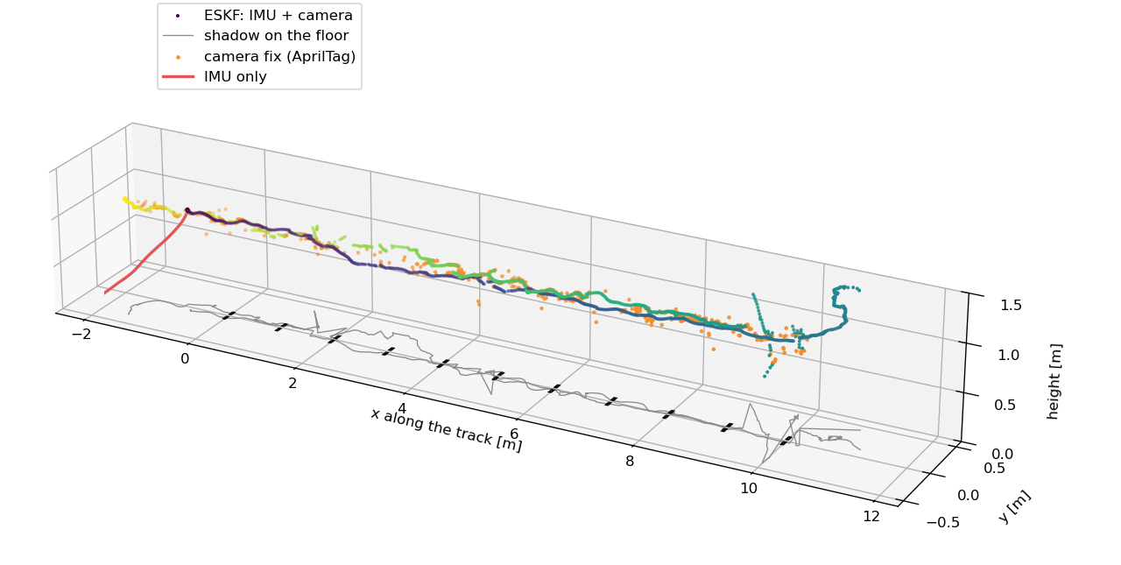
HOURS 30 TO 40 SIMULATE AND PROVE
H3
H10
H24
H30
H40
Post processing of IMU+Video data
33.8 m
walked along the track
14 cm
ESKF to camera at the end
44 %
Of the video always has a tag within the frame
Notes:
Real walk along the tag track, five lengths, 33.8 metres. Orange dots are the camera fixes, the coloured line is the ESKF, the red stub is the IMU on its own. The ESKF ends 14 centimetres from the camera's own estimate, and the camera only has a fix 44 percent of the time, the IMU carries the rest.

Slide 21
THE 40 HOUR STORY
What 40 hours bought us
395 Hz
1 hour
0.14 m
0.138 m
14 cm
clean phone IMU stream, zero lost
of static data behind the noise model
i-ASL RMSE after the fixes
Gazebo RMSE against ground truth
real walk, IMU plus camera
Next
Real UWB anchors on hardware. UWB is validated on i-ASL data and in simulation, the real walk uses the camera.
Github Repo link
Notes:
Close on the numbers and be honest about the edge: UWB is validated on a public dataset and in simulation; the real world walk uses a camera as the correction sensor because we did not have UWB hardware. The next step is exactly that: real anchors. Everything, code, plots, videos and the one hour recording, is in the repo.

